Slide 1




G.H. RAISONI COLLEGE OF ENGINEERING
AND MANAGEMENT, WAGHOLI, PUNE.
Department of AI & AIML
Real-Time Face Mask Detection
Guide:
Prof. Abhijit Khadke
Name of Projectees
Probal Kar Smita Jagdale
A-49 A-56

Slide 2
Contents
Introduction
Justifications for Selecting the Title
Problem Statement
Literature Survey
Block Diagram
Expected Result
Work plan
References

Slide 3
Introduction
  The Real-Time Face Mask Detection project employs advanced deep learning techniques to address public safety concerns during the pandemic.
  The project's primary focus is automating the real-time detection of individuals wearing face masks in public spaces, promoting adherence to health guidelines.
  By combining deep learning with real-time video processing, the project showcases the potential of technology to contribute to responsible behavior and public health.
  In the upcoming slides, we'll explore the project's components, workflow, and impact on safety awareness.

Slide 4
Justification For Selecting The Title
Title : Real-Time Face Mask Detection
- Clarity and Precision: The title clearly communicates our project's core mission: instant identification of face mask presence.
- Timely Insights: "Real-Time" underscores our ability to provide immediate results, crucial in dynamic health scenarios.
- Technological Innovation: We leverage advanced computer vision and machine learning for mask detection.
- User-Centric: Our system provides timely feedback to individuals about mask compliance.
- Versatile Application: Applicable in diverse settings for public health and safety.
- Relevance: Addresses pressing health concerns, ensuring responsible mask usage.

Slide 5
Problem Statement
Problem Identified:
The problem identified is the absence of an efficient and automated system for monitoring and promoting real-time face mask compliance in public settings during health crises.
Problem Statement:
In the midst of health crises, there is a pressing need for a technological solution that can instantly detect and encourage the use of face masks in real-time. Existing methods reliant on manual intervention are resource-intensive and error-prone, hindering the effectiveness of public health measures. This project aims to address this challenge by developing a "Real-Time Face Mask Detection" system, providing immediate feedback and education to individuals, ultimately enhancing public safety and health awareness.

Slide 6
Literature Survey
Sr. No. | Paper Title and its Author | Details of Publication | Findings
1 | Covid-19 Face Mask Detection Using TensorFlow, Keras and OpenCV ~ Arjya Das, Mohammad Wasif Ansari, Rohini Basak | Published in: 2020 IEEE 17th India Council International Conference (INDICON) | The proposed method detects the face from the image correctly and then identifies if it has a mask on it or not. It can also detect a face along with a mask in motion.
2 | Face mask detection using deep learning: An approach to reduce risk of Coronavirus spread ~ Shilpa Sethi, Mamta Kathuria, Trilok Kaushik | Received 28 September 2020, Revised 10 June 2021, Accepted 20 June 2021, Available online 24 June 2021, Version of Record 3 July 2021. | The proposed model efficiently handles varying kinds of occlusions in dense situation. The model is 98.2% accurate at mask detection.
3 | Facial Mask Detection Using Depthwise Separable Convolutional Neural Network Model During COVID-19 Pandemic ~ Asghar MZ, Albogamy FR, Al-Rakhami MS, Asghar J, Rahmat MK, Alam MM, Lajis A and Nasir HM | Published: 07 March 2022 Edited by: Thippa Reddy Gadekallu, VIT University, India | Depthwise Separable Convolution Neural Network based on MobileNet (DWS-based MobileNet) utilizes depth-wise separable convolution layers instead of 2D convolution layers. With limited datasets, the DWS-based MobileNet performs exceptionally well.
4
5
6

Slide 7
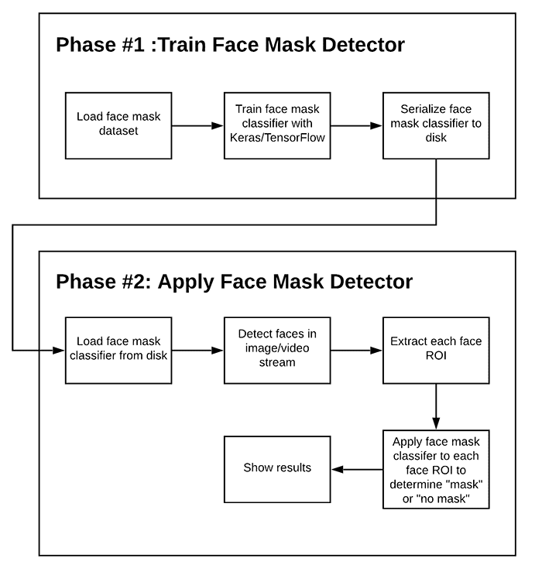
Block Diagram

Slide 8
Expected Result
1. Real-Time Face Mask Detection: Accurate and real-time detection of individuals wearing or not wearing face masks is the primary objective. This result is crucial for promoting mask compliance and public safety during health crises.
2. Age Estimation: When individuals are not wearing masks, the system should estimate their ages, providing insights into the demographics of mask-wearing behavior.
3. Gender Estimation: Similarly, the system should estimate the gender of individuals not wearing masks, offering gender-related data for analysis.

Slide 9
Work – Plan
Months Activities | August’23 | Sept’23 | Oct’23 | Nov’23
Literature Reviews | √
Requirement Analysis | √
Designing | √
Experimental Analysis | √ | √ | √
Module wise Implementation |  | √ | √
Testing and Debugging |  |  | √ | √
Preparation of Project Report |  |  |  | √

Slide 10
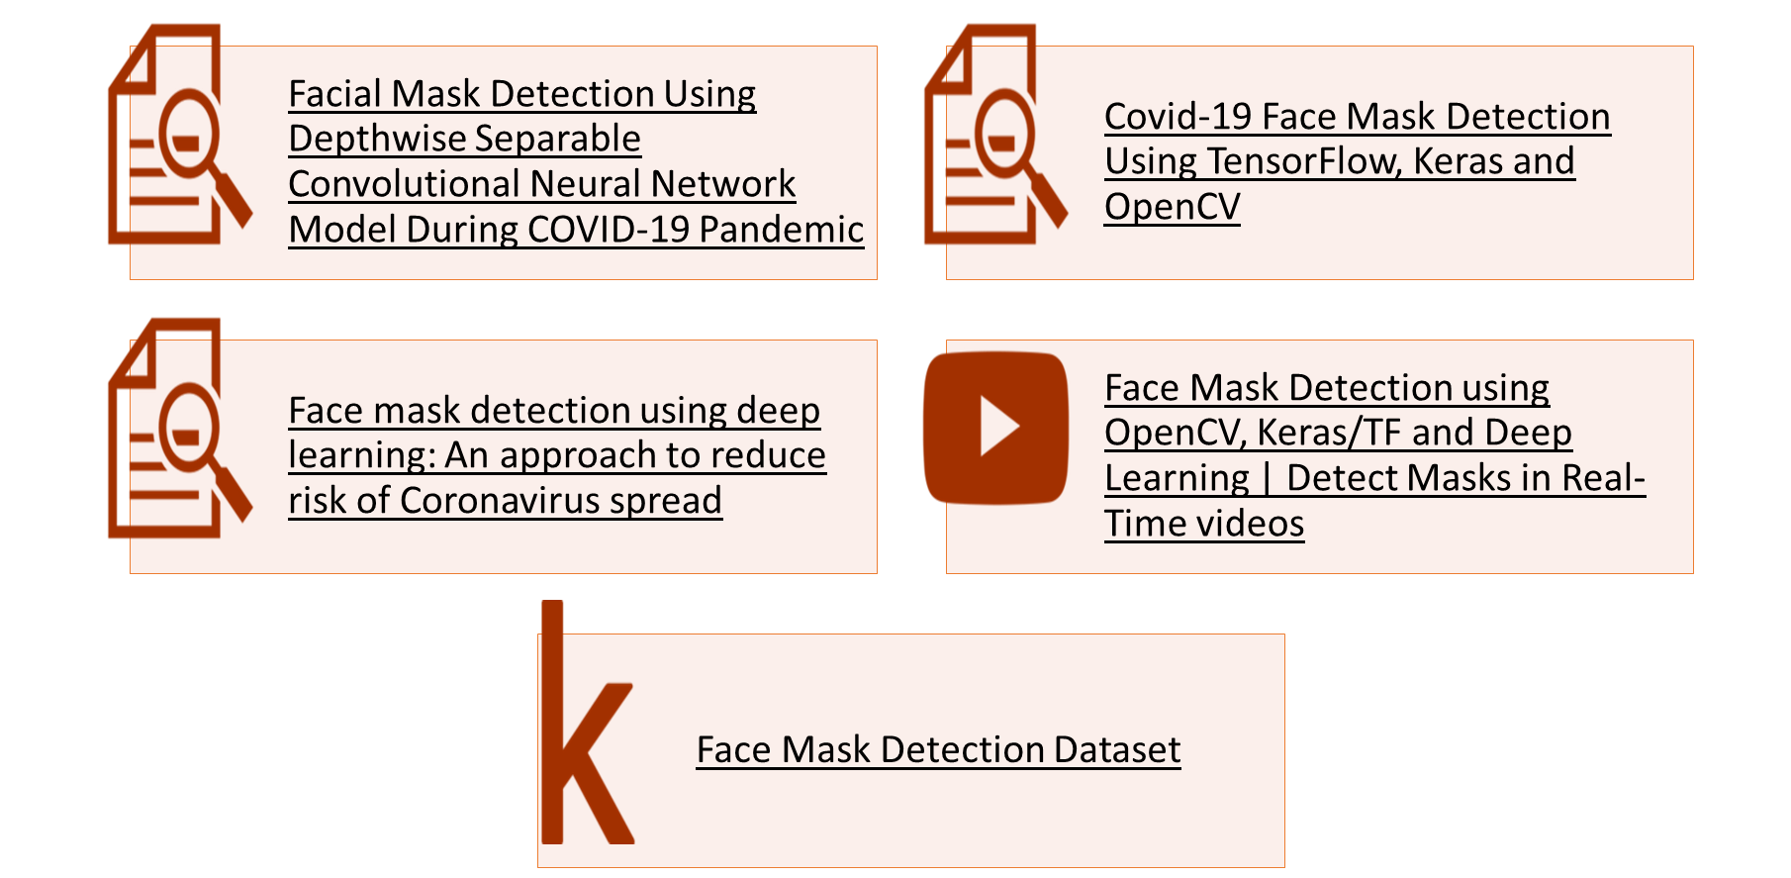
References

Slide 11
Thank you !

